Slide 1

Semantic Literature Reviews - project 2
Michał Gozdera, Małgorzata Hadasz, Krystian Kurek

Slide 2
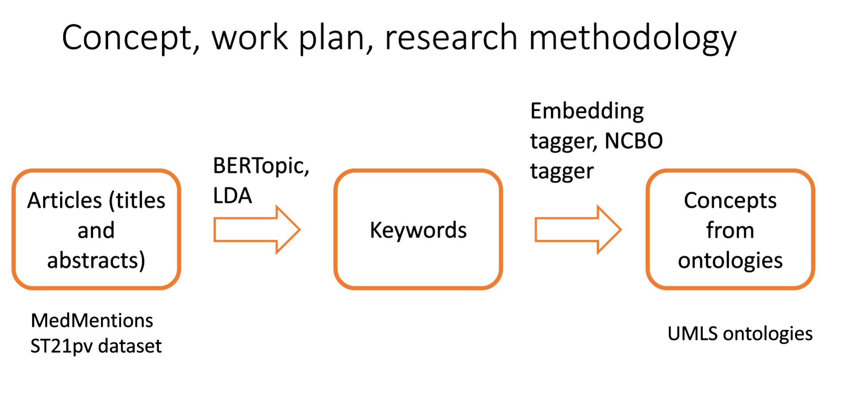
Project 1 recap

Slide 3
Project 1 limitations and Project 2 main goal
SLR pipeline in Project 1 – difficult to evaluate
MEDMentions dataset inconsistencies
Main goal in project 2: Improve evaluation process

Slide 4
Project 2 - tasks
Replace problematic MEDMentions dataset with CRAFT dataset
1
Check the entire pipeline evaluation metrics on CRAFT dataset
2
Develop techniques to evaluate only keywords extraction part (not the whole pipeline)
3
Investigate the influence of hyperparams on keywords extraction
4
Try new disambiguation approaches
5
Try new tagger (MedCAT)
6

Slide 5
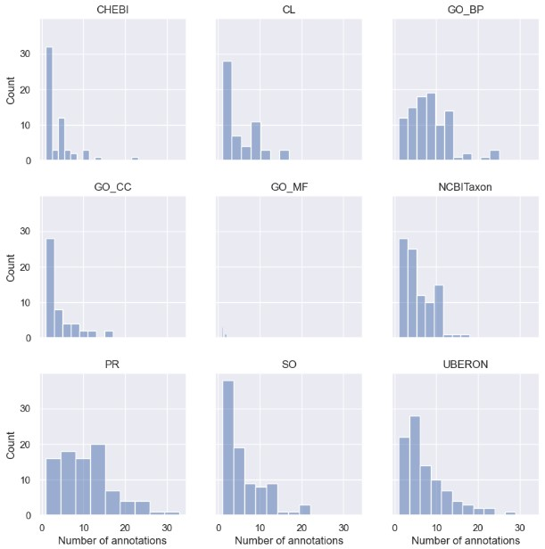
CRAFT data
97 articles
Used whole texts (not only abstarcts)
Tagged with 9 ontologies
Tokenization, Lemmatization

Slide 6
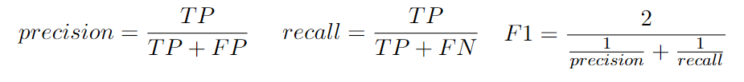
Keywords extraction evaluation
CRAFT dataset contains mentions that were annotated manually
Our intuition: keywords extractors should find such words that would be more or less consistent with mentions chosen by human-annotators
Our idea: Calculate metrics:

Slide 7
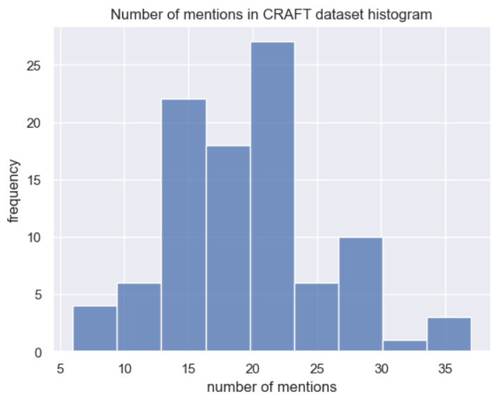
How many keywords should we extract?

Slide 8
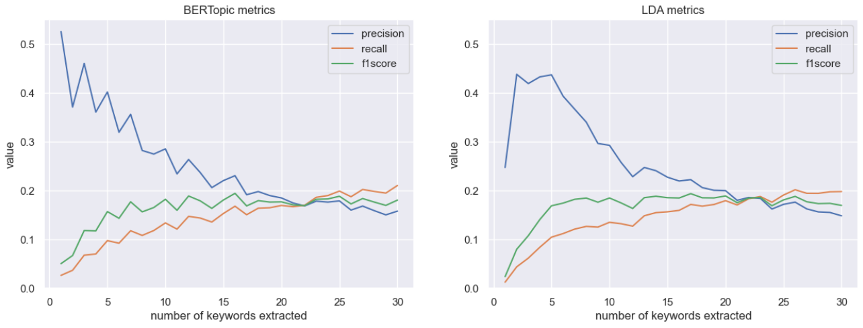
Keywords extraction evaluation - number of keywords dependence, BERTopic vs LDA

Slide 9
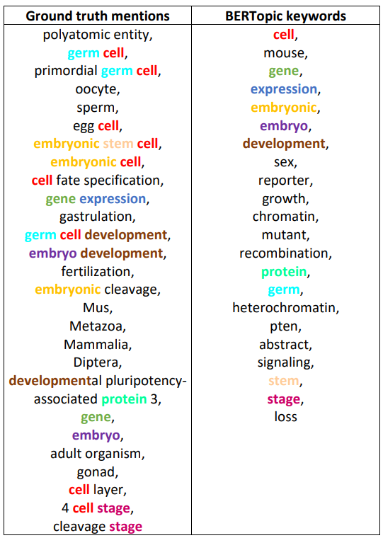
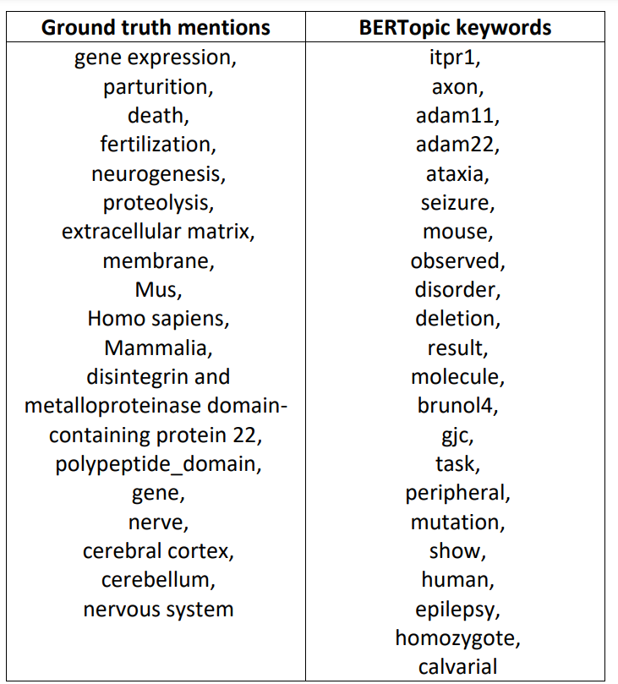
BERTopic for 22 kws – bad and good results

Slide 10
BERTopic – good result: paper abstract
Abstract
In mice, germ cells are specified through signalling between layers of cells comprising the primitive embryo. The function of Dppa3 (also known as Pgc7 or stella), a gene expressed in primordial germ cells at the time of their emergence in gastrulating embryos, is unknown, but a recent study has claimed that it plays a central role in germ cell specification.
To test Dppa3's role in germ cell development, we disrupted the gene in mouse embryonic stem cells and generated mutant animals. We were able to obtain viable and fertile Dppa3-deficient animals of both sexes. Examination of embryonic and adult germ cells and gonads in Dppa3-deficient animals did not reveal any defects. However, most embryos derived from Dppa3-deficient oocytes failed to develop normally beyond the four-cell stage.
We found that Dppa3 is an important maternal factor in the cleavage stages of mouse embryogenesis. However, it is not required for germ cell specification.

Slide 11
BERTopic – bad result: paper abstract
Abstract
ADAM22 is a member of the ADAM gene family, but the fact that it is expressed only in the nervous systems makes it unique. ADAM22's sequence similarity to other ADAMs suggests it to be an integrin binder and thus to have a role in cell-cell or cell-matrix interactions. To elucidate the physiological functions of ADAM22, we employed gene targeting to generate ADAM22 knockout mice.
ADAM22-deficient mice were produced in a good accordance with the Mendelian ratio and appeared normal at birth. After one week, severe ataxia was observed, and all homozygotes died before weaning, probably due to convulsions. No major histological abnormalities were detected in the cerebral cortex or cerebellum of the homozygous mutants; however, marked hypomyelination of the peripheral nerves was observed.
The results of our study demonstrate that ADAM22 is closely involved in the correct functioning of the nervous system. Further analysis of ADAM22 will provide clues to understanding the mechanisms of human diseases such as epileptic seizures and peripheral neuropathy.

Slide 12
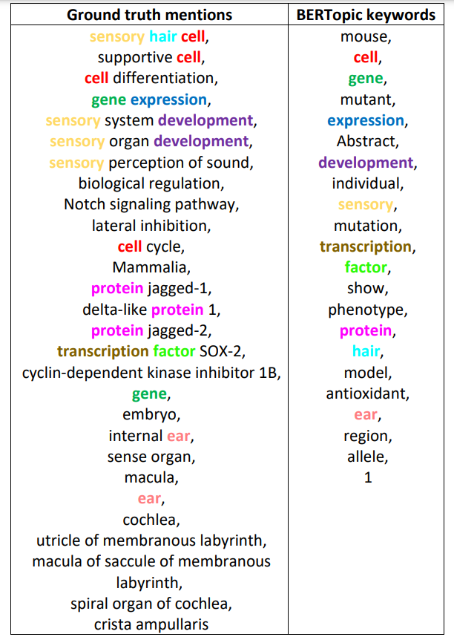
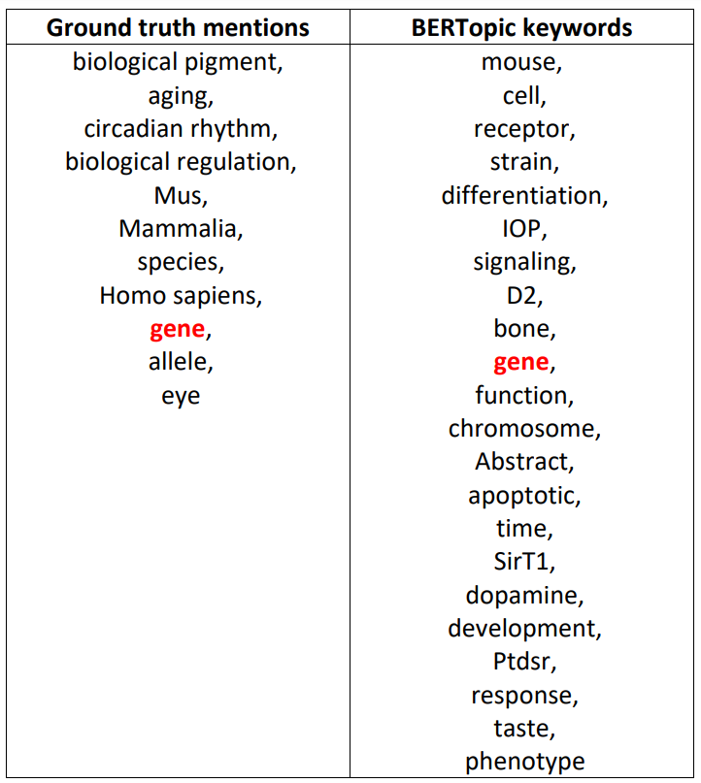
LDA for 22 kws –bad and good results

Slide 13
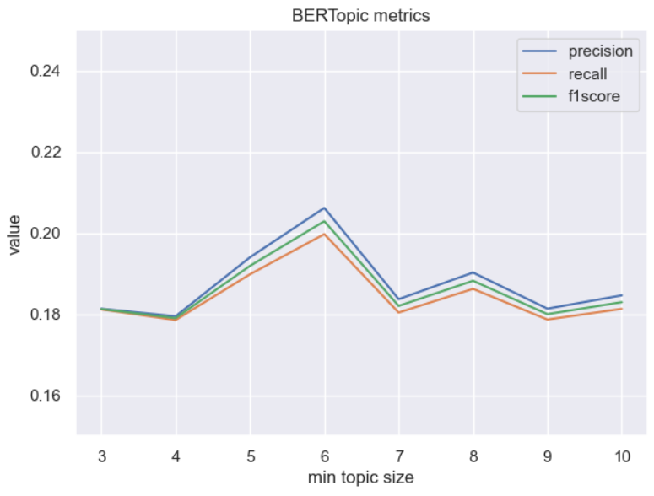
BERTopic on min cluster size

Slide 14
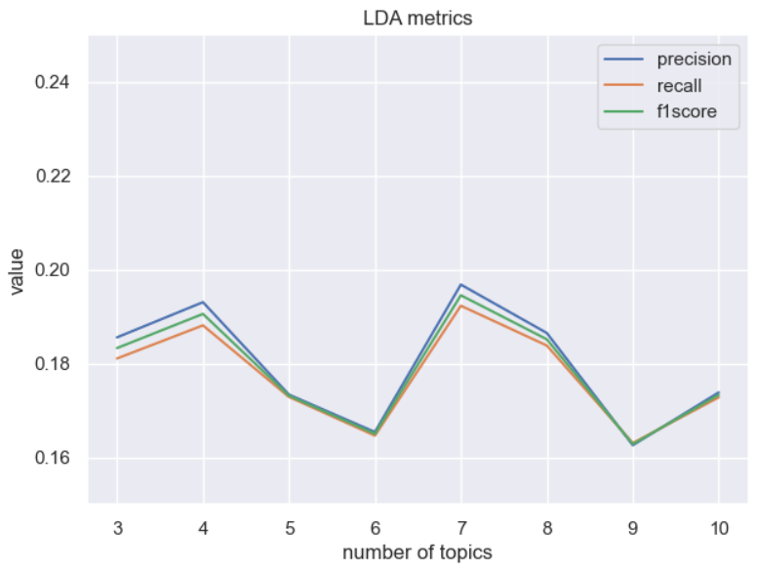
LDA on number of topics

Slide 15
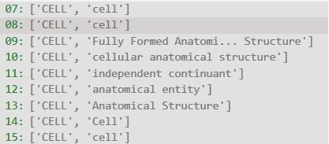
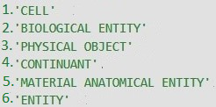
Disambiguation - sorting
Sorted based on frequency

Slide 16
Disambiguation - sorting
Sorted based on frequency

Slide 17
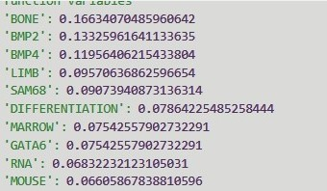
Disambiguation - weighting
Weights taken from the keyword extraction phase​
When choosing the base concept more important keywords have stronger vote​

Slide 18
Disambiguation - weighting
Weights taken from the keyword extraction phase​
When choosing the base concept more important keywords have stronger vote​

Slide 19
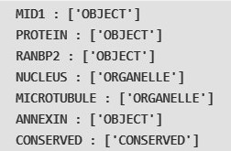
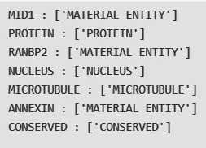
Disambiguation - forcing
After forcing

Slide 20
Disambiguation - forcing
After forcing

Slide 21
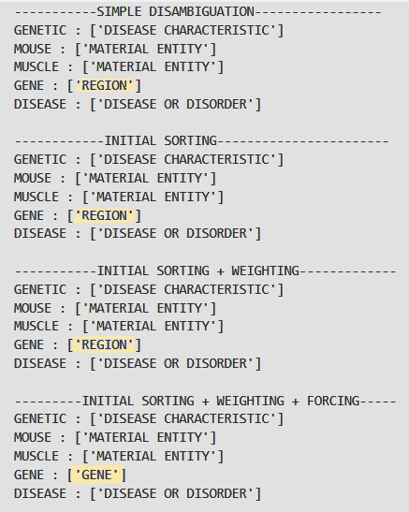
Disambiguation - comparison
Nor sorting neither weighting made difference​
The only difference in GENE while forcing​

Slide 22
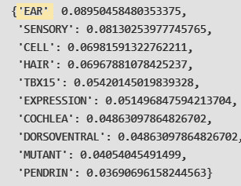
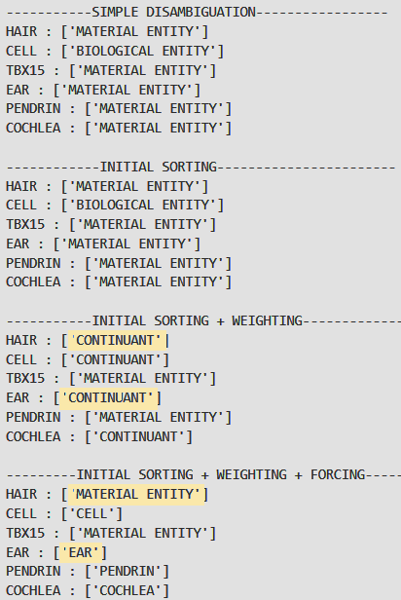
Disambiguation - comparison

Slide 23
MedCAT
List of ontologies used in CRAFT:
MONDO
MOP
PR
SO
UBERON
❌
❌
❌
❌
❌
GO
NCBITaxon
CHEBI
CL
✅
✅
❌
❌

Slide 24
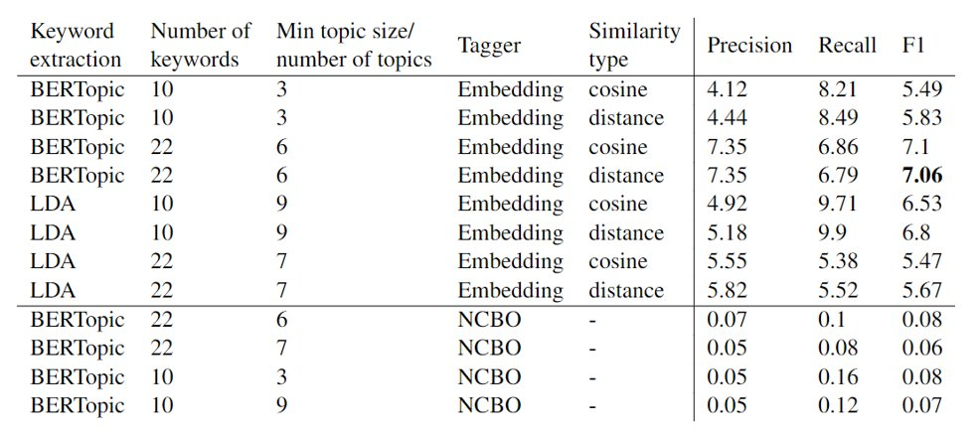
Results

Slide 25
Thank you :)

